Slide 1
Demographic Transition Model
Sem- V

Slide 2
Stage 1 - High Fluctuating
Birth Rate and Death rate are both high. Population growth is slow and fluctuating.
Reasons
Birth Rate is high as a result of:
Lack of family planning
High Infant Mortality Rate: putting babies in the 'bank'
Need for workers in agriculture
Religious beliefs
Children as economic assets
Death Rate is high because of:
High levels of disease
Famine
Lack of clean water and sanitation
Lack of health care
War
Competition for food from predators such as rats
Lack of education
Typical of Britain in the 18th century and the Least Economically Developed Countries (LEDC's) today.

Slide 3
Stage 2 - Early Expanding
Birth Rate remains high. Death Rate is falling. Population begins to rise steadily.
Reasons
Death Rate is falling as a result of:
Improved health care (e.g. Smallpox Vaccine)
Improved Hygiene (Water for drinking boiled)
Improved sanitation
Improved food production and storage
Improved transport for food
Decreased Infant Mortality Rates
Typical of Britain in 19th century; Bangladesh; Nigeria

Slide 4
Stage 3 - Late Expanding
Birth Rate starts to fall. Death Rate continues to fall. Population rising.
Reasons
Family planning available
Lower Infant Mortality Rate
Increased mechanization reduces need for workers
Increased standard of living
Changing status of women
Typical of Britain in late 19th and early 20th century; China; Brazil

Slide 5
Stage 4 - Low Fluctuating
Birth Rate and Death Rate both low. Population steady.
Typical of USA; Sweden; Japan; Britain

Slide 6
Demographic Transition Model Applied Revision Table
Area Birth Rate Reason Death Rate Reason LEDCs High No contraception
Couples have many babies to compensate for the high death rate caused by poor health care
Large families need to work on the land to contribute to family income
Children look after old
Religious reasons High Poor medical facilities
Disease
Poor nutrition
High Infant mortality NICs High/
Decreasing People are used to having many children. Takes time for culture to change
Changing status of women Decreasing As an economy develops money becomes available for better health care
Housing improves
Better childcare MEDCs Low Children are expensive
People know their children are going to survive so they can keep their families small
Widely available contraceptives
Changing status of women Low Better health care
Be

Slide 7
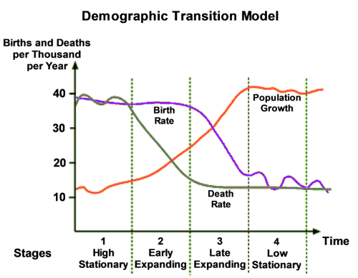

Slide 8
THANK YOU

